Slide 1
Productionizing R code with Docker
SLC R Users Group 2020-08-19
Mark Nielsen
Lead Machine Learning Engineer

Slide 2
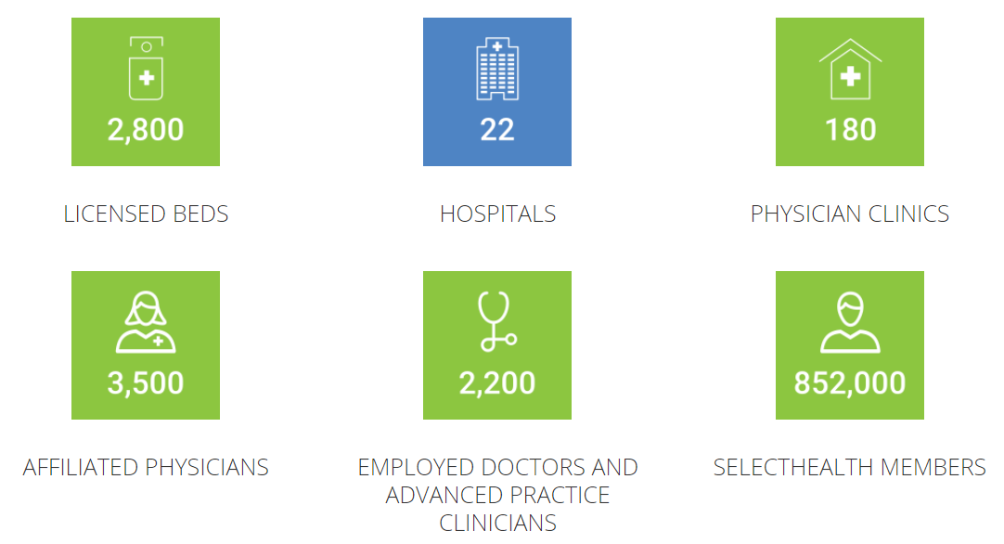
Quick facts about Intermountain Healthcare

Slide 3
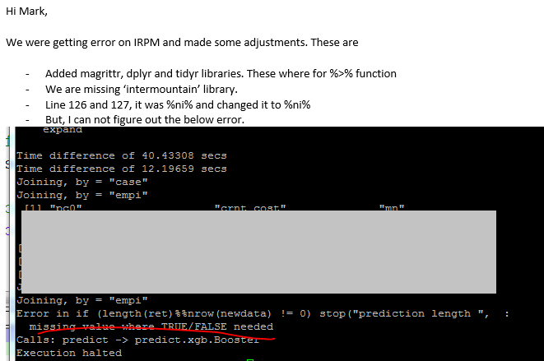

Slide 4
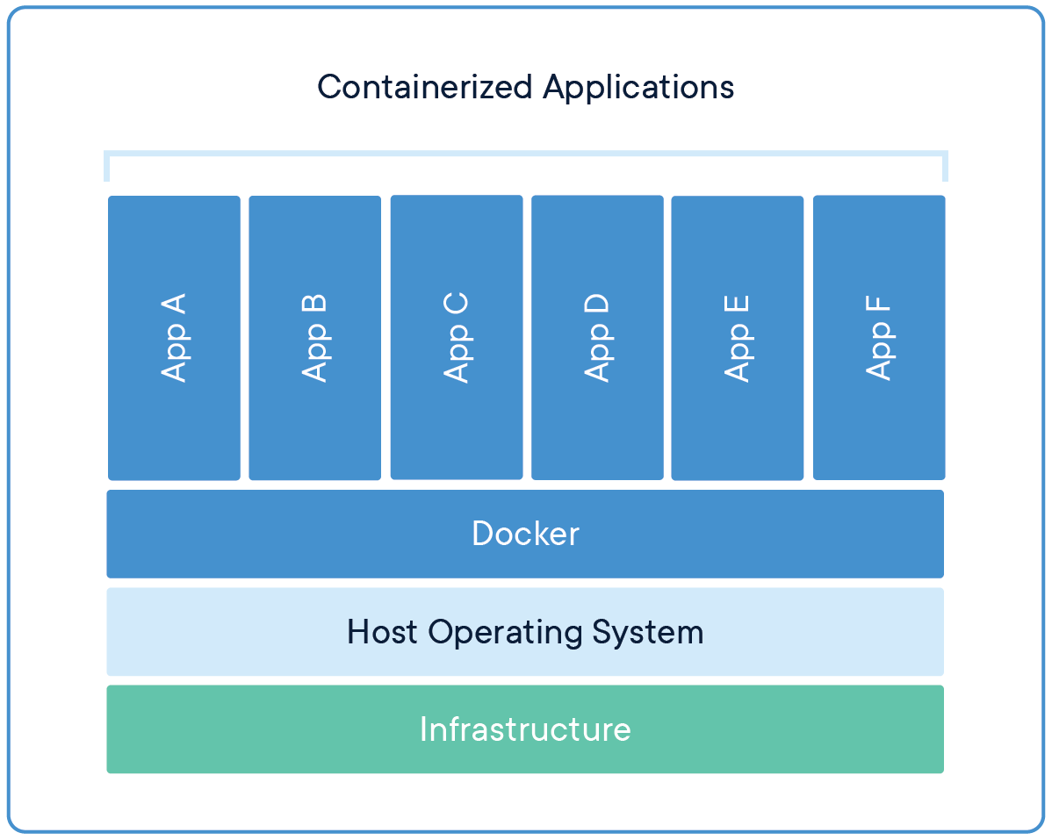
Why Docker?
Create my own replicable environment
Easily push from DEV to PROD
sudo in container
Generated instructions can also be used as reference
Minimized Linux administration
Scalable with other tools
Someone has already built it!
https://www.docker.com/resources/what-container

Slide 5
Building a Container
Basic Commands/Syntax

Slide 6

Container Recipe
Create a project folder
Write Dockerfile “ingredients”
Add any app specific files to project folder
Build the container
(Dockerfile is built sequentially)
Run container
https://docs.docker.com/get-started/
https://docs.docker.com/engine/reference/builder/

Slide 7
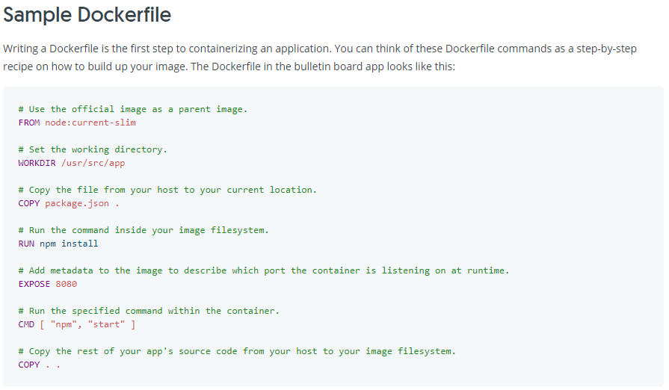

Slide 8
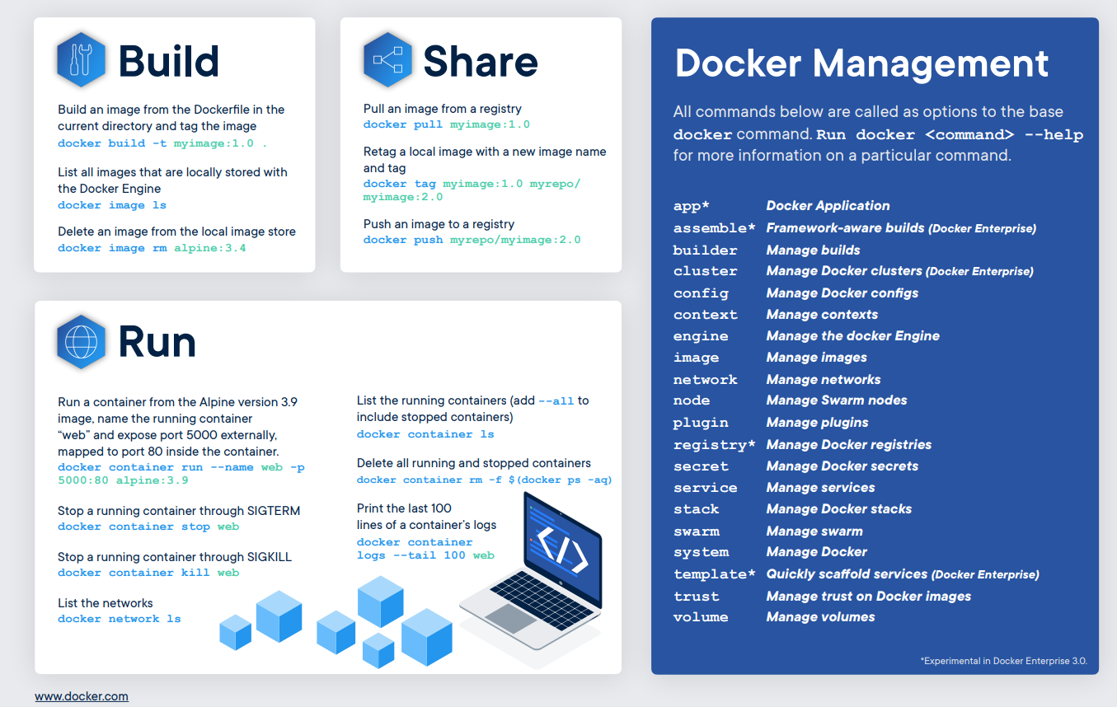

Slide 9
Hello World Demo

Slide 10
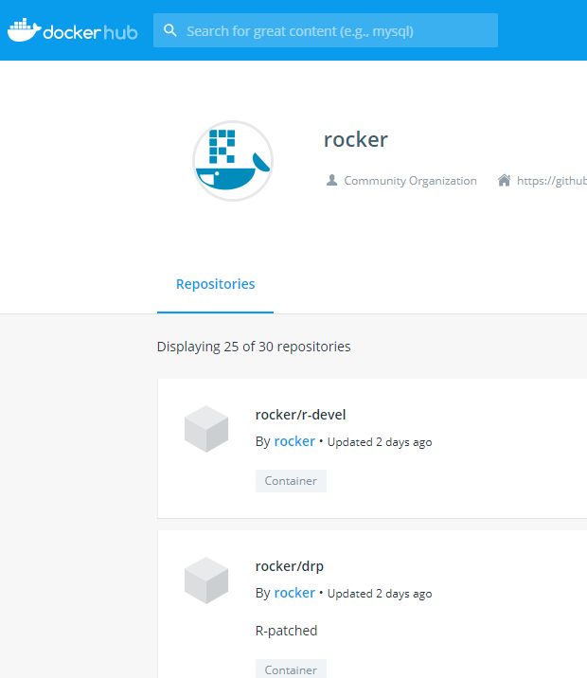
Rocker
It’s already been built!
Shiny Server
RStudio Server
Tensorflow
Etc.
RStudio also creates and distributes docker containers:
https://hub.docker.com/u/rstudio

Slide 11
Plumber w/ ggplot2 Demo

Slide 12
Docker at Intermountain
Batch Models

Slide 13
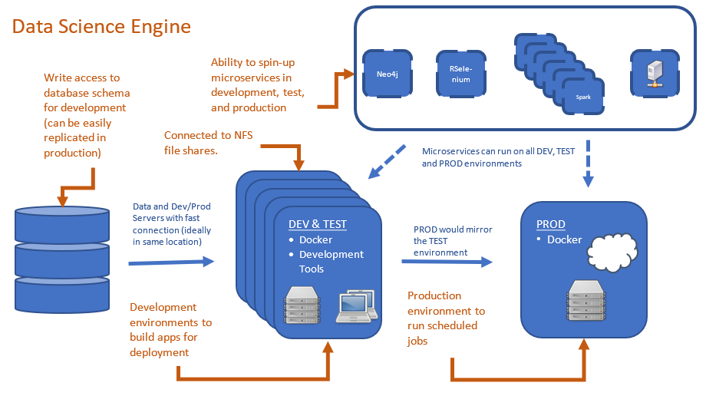
Notes:
Point out that with docker setting up Selenium was SUPER easy!

Slide 14
Docker at Intermountain
Plumber App Example

Slide 15
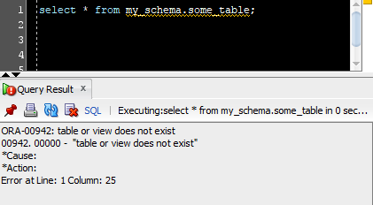
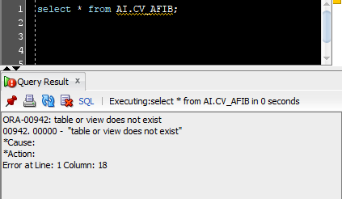
Fake table
Real table

Slide 16
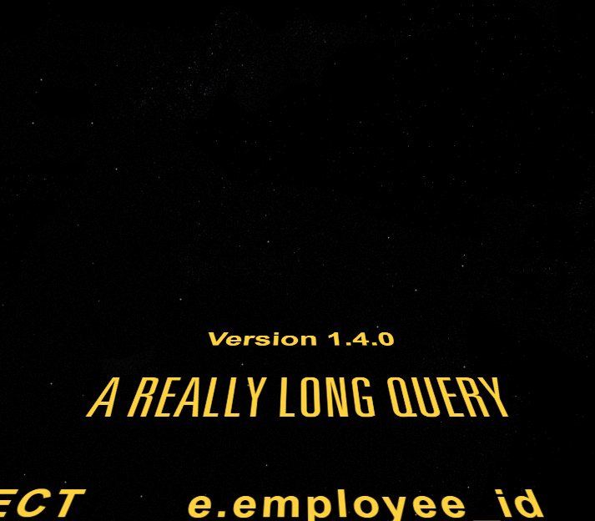
Role Finding Problems
Analyst share knowledge through SQL
You need to enter credentials to connect to the metadata.
Queries can get REALLY long!
New employees have very limited access due to governance.

Slide 17
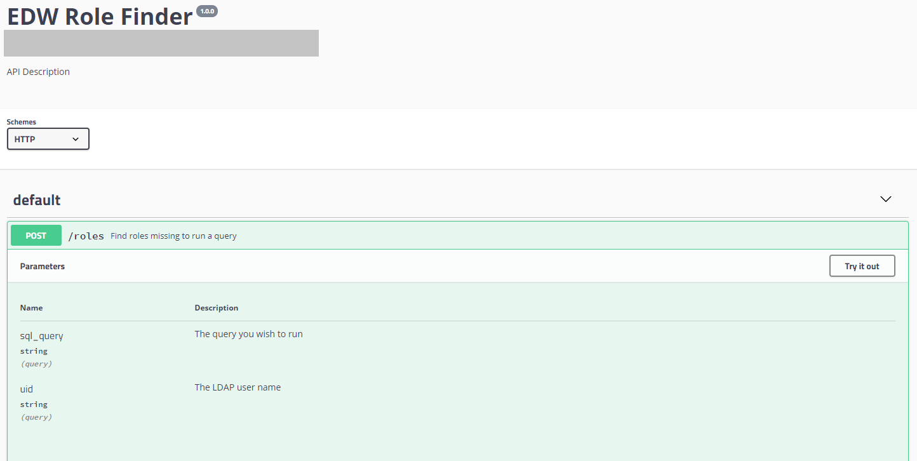
Notes:
Set up app user credentials and create API to make this so anyone can run it. Previous versions of this app used selenium to hit a minimal web application set up, but this was slow.

Slide 18
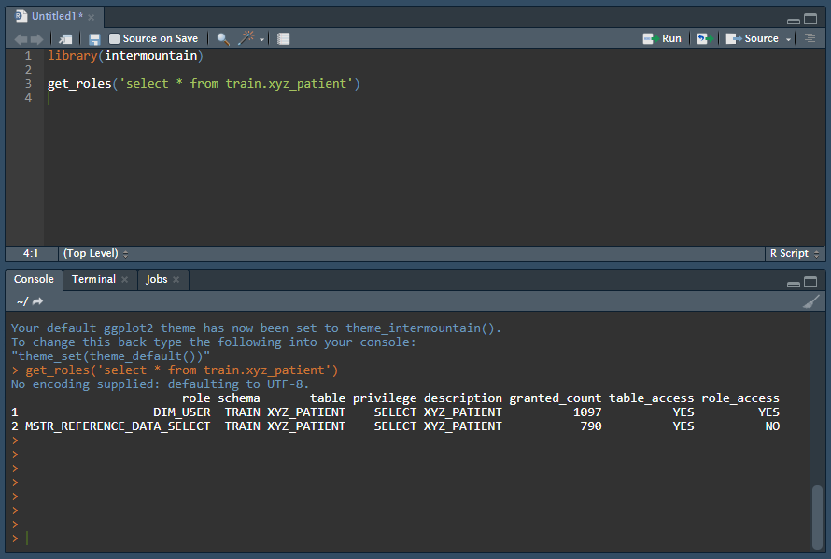

Slide 19
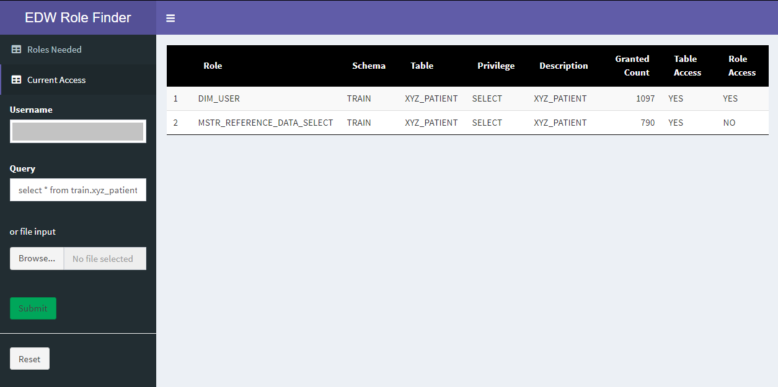

Slide 20
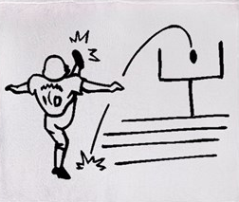

Docker for the win!
Data scientists keep control over their environment
DEV to PROD is easy
“Freezes” projects in a steady state.
Less Linux administration need
Projects have documented requirements (Dockerfile)
Containers are easily shared (Dockerhub or Portus)

Slide 21
Next Steps
Automation, docker-compose, Kubernetes, etc.

Slide 22
Thank you!

